Slide 1
Genetics Lab
3-point mapping
How to use F2 data to create a map of 3-linked genes

Slide 2
There are further limitations to recombination mapping
  Consider again, genes that are distantly spaced on the same chromosome. They are more likely to have more than one X.0. occur between them.

Slide 3
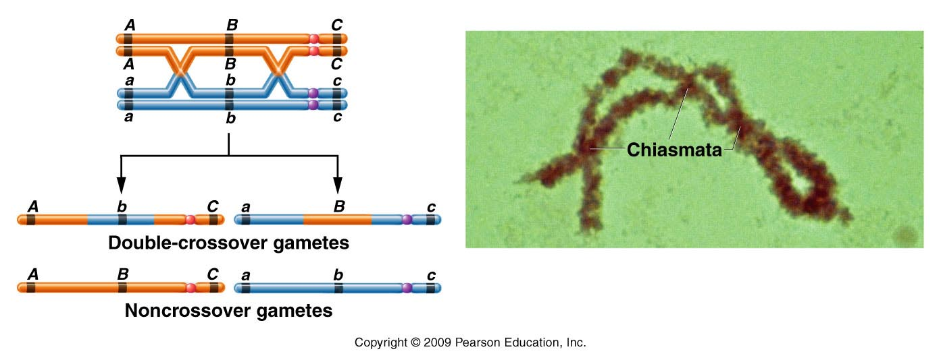
Figure 5.7ab
Notes:
Figure 5-7ab Consequences of a double exchange occurring between two nonsister chromatids. Because the exchanges involve only two chromatids, two noncrossover gametes and two double-crossover gametes are produced. The photograph illustrates several chiasmata found in a tetrad isolated during the first meiotic prophase stage.

Slide 4
Consider genes a, b, and c
Offspring should show new (non parental) combinations of a and b alleles.
Offspring should show new (non parental) combinations of b and c alleles.
a and c alleles remain in parental combinations.
*Depending on the gene(s)/trait(s) analyzed, it’s difficult or impossible to note XO occurred.

Slide 5
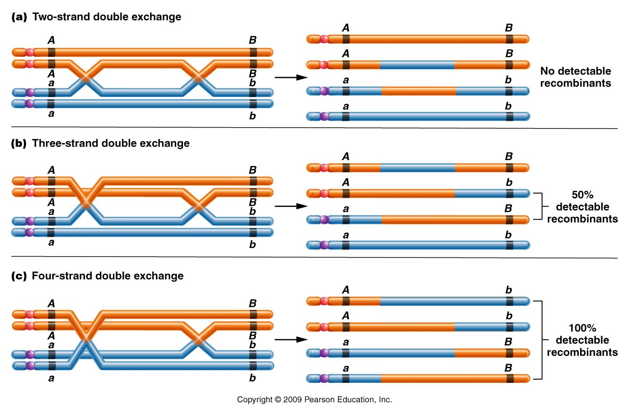
The sister chromatids involved in the crossovers can also obscure/confuse the observation of recombination between linked genes.
Observe 3 examples in which 2 XO occurred between A and B
Figure 5.12
Notes:
Figure 5-12 Three types of double exchanges that may occur between two genes. Two of them, (b) and (c), involve more than two chromatids. In each case, the detectable recombinant chromatids are bracketed.

Slide 6
Reminder…
Recombination mapping has limitations
We may over- or underestimate the distance between 2 genes.
Bottom line…recombination mapping is most accurate for more closely spaced loci.
  However…multiple cross-overs help us in certain aspects of mapping----Putting genes in a linear order.

Slide 7
Recall… Initially mapping required multiple, 2-point crosses. Then the 2-point crosses could be put together to make a map with gene order and distances.
Sturtevant noted that recombination frequencies were approximately additive, allowing the order of genes to be determined.
In 3 separate crosses:
  y-w frequency is 0.5%
  w-m frequency is 35.4
  y-m frequency is 34.5 %
**Which genes are on the outside? Which gene is in the middle?

Slide 8
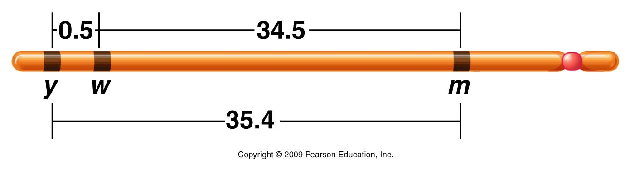
Figure 5.4
Notes:
Figure 5-4 A map of the yellow (y), white (w), and miniature (m) genes on the X chromosome of Drosophila melanogaster. Each number represents the percentage of recombinant offspring produced in one of three crosses, each involving two different genes.

Slide 9
Discovery that multiple X.O can occur between loci actually simplified chromosome mapping, allowing multiple loci to be mapped in a single cross.

Slide 10
Consider again, genes that are distantly spaced on the same chromosome. They are more likely to have more than one X.0. occur between them.

Slide 11
Some background…
How are single and multiple X.O. related?…
  Crossover in any interval is related to the physical distance between loci.
c
a
b
7 cM
12 cM

Slide 12
c
a
b
7 cM
12 cM
The map was made by observing recombination frequencies.
a-b 0.07
b-c 0.12
What is the expected frequency of double crossover in the interval a-c?
(One X.O. in a-b and one X.O. in b-c)

Slide 13
Assuming X.O in one interval does not influence X.O. in the other interval we can use the product rule.
a-b (0.07) X b-c (0.12) =0.0084
  Frequency of double cross over (DCO) is only .84%

Slide 14
What would DCO look like in this map?
Sketch on board…

Slide 15
What would DCO look like in this map?
X
X
Sketch on board…

Slide 16
* Single crossover in A-B and B-C regions would be expected to be more frequent than DCO frequency.
Figure 5.7ab
Notes:
Figure 5-7ab Consequences of a double exchange occurring between two nonsister chromatids. Because the exchanges involve only two chromatids, two noncrossover gametes and two double-crossover gametes are produced. The photograph illustrates several chiasmata found in a tetrad isolated during the first meiotic prophase stage.

Slide 17
Knowing DCO occur much more rarely than SCO allows us to determine gene order in a multi-point cross.
Start with 3-point cross…

Slide 18
3 basic requirements for successful 3-point mapping
Organism doing the X.O/ recombination must be heterozygous for all loci under consideration

Slide 19
Cross design must allow for direct observation of crossing over in gametes as a phenotype in offspring.
  Usually the mate contributes only recessive alleles.

Slide 20
Sufficient numbers of offspring must be examined to recover a representative sample of all crossover classes.

Slide 21
Knowing the design of the cross, 3 types of offspring should be evident.
  Non-crossover (NCO). Offspring derived from gametes in which no crossover occurred in the interval of interest.
  Single-cross-over (SCO) Offspring derived from gametes in which crossover occurred in one of the 2 intergene regions. **2 different SCO are produced.
  Double cross-over (DCO) Offspring derived from gametes in which crossover occurred in both intergene regions of interest.

Slide 22
NCO (parental combinations) will be the most frequent—Although XO happens, it can happen anywhere along the chromosome. Not always in the interval you are analyzing.
DCO will be the least frequent
SCO1
will show intermediate frequencies reflecting the intergene distances.
SCO 2

Slide 23
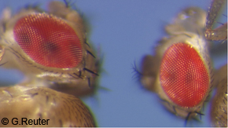
Textbook example…
3 X-linked genes in example
w-white eyes
y-yellow body 3 recessive mutations
ec-echinus (eye shape)

Slide 24
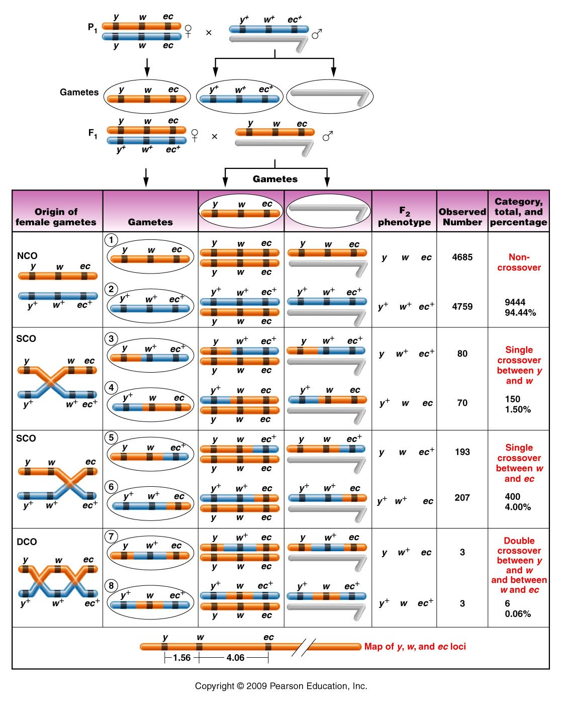
Cross is made to produce female heterozygote and completely recessive male.
Figure 5.8
Notes:
24
Figure 5-8 A three-point mapping cross involving the yellow (y or y⁺), white (w or w⁺), and echinus (ec or ec⁺) genes in Drosophila melanogaster. NCO, SCO, and DCO refer to noncrossover, single-crossover, and double-crossover groups, respectively. Centromeres are not drawn on the chromosomes, and only two nonsister chromatids are initially shown in the left-hand column.

Slide 25
Cross is made to produce female heterozygote and completely recessive male.
Figure 5.8
Notes:
25
Figure 5-8 A three-point mapping cross involving the yellow (y or y⁺), white (w or w⁺), and echinus (ec or ec⁺) genes in Drosophila melanogaster. NCO, SCO, and DCO refer to noncrossover, single-crossover, and double-crossover groups, respectively. Centromeres are not drawn on the chromosomes, and only two nonsister chromatids are initially shown in the left-hand column.

Slide 26
What are the possible orders for 3 genes?
y-ec-w (w-ec-y)
y-w-ec (ec-w-y)
w-y-ec (ec-y-w)

Slide 27
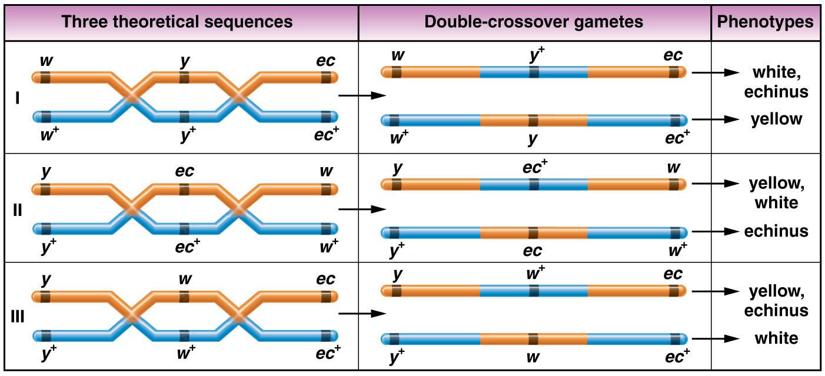
Figure 5–9 The three possible sequences of the white, yellow, and echinus genes, the results of a double crossover in each case, and the resulting phenotypes produced in a testcross.

Slide 28
Go back to the table, and identify how the genes would change to make DCO.
Play with the orders to turn NCO to DCO.
The order should be revealed.

Slide 29
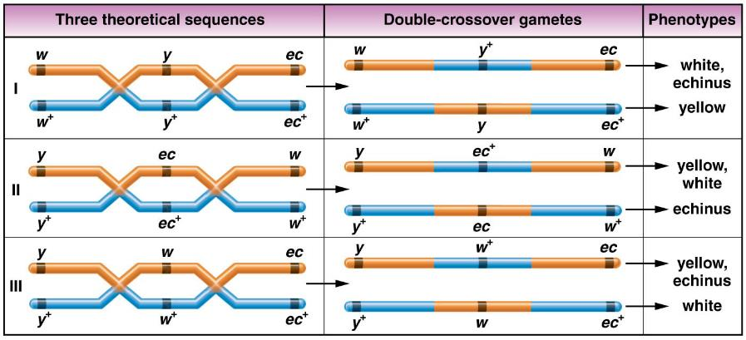
Figure 5–9 The three possible sequences of the white, yellow, and echinus genes, the results of a double crossover in each case, and the resulting phenotypes produced in a testcross.

Slide 30
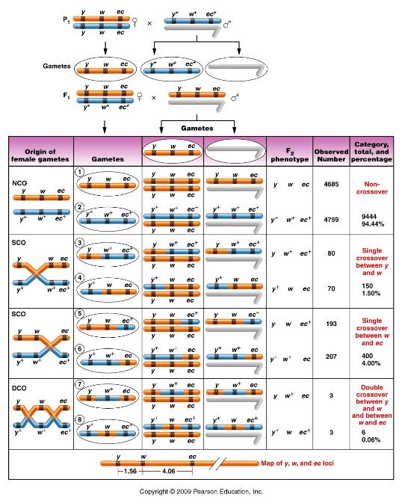
Which offspring
were DCO from
the data?

Slide 31
Your data shows DCO are consistent with w in the middle.
Reorder your data to identify the 2 different SCO categories….

Slide 32
Determining the distances…
Distance is determined as before…using recombination frequency.
Recombination is sum of SCO (for that interval) and DCO, since DCO occur in both intervals.

Slide 33
Determining the distances…
y
w
ec
SCO = 1.5%
DCO = 0.6%
1.56 cM
SCO = 4.0%
DCO = 0.6%
4.06 cM

Slide 34
Now sketch the cross (cross A) that we have set up with our flies and review how we will be able to map the X-linked genes, y, m, and w.

